Slide 1


Titolo presentazione sottotitolo
SafeStreets
Milano, XX mese 20XX
Samuele Moscatelli 940515
Andrea Pozzoli 944031

Slide 2


Firma convenzione Politecnico di Milano e Veneranda Fabbrica del Duomo di Milano
Requirement Analysis and Specification Document
Aula Magna – Rettorato
Mercoledì 27 maggio 2015

Slide 3
Goals of the System – EndUser (G1)
G1 A person (end user) who sees a traffic violation should be able to notify authorities of the violation in every moment and situation (such as with lack of internet connection), participating to street regulation.
R1 When a user sees a traffic violation, SafeStreets application must allow him to take a picture of it, insert a description and immediately send the information to authorities.
R2 When an end user sends a violation report, SafeStreets application must detect automatically the date, the time and the position from the device. The position is taken from the GPS of the user’s device.
R4 When the picture of the violation inserted by the end user is not readable by the application, the system must ask him to insert it again or to write manually the license plate number.
R5 When a violation is sent, SafeStreets dispatching software must find the nearest authority users and notify them.
D1 A person (end user) knows the traffic rules.
D2 A person (end user) knows that he can notify the authority if there
is a traffic violation.
D3 A person (end user) has a device with a camera, internet connec- tion and GPS sensor.
D4 A user (End user, Authority or municipality) knows SafeStreets and has a device on which there is SafeStreets software and inter- net connection.
D5 Users are fair with each other, so they do not lie when reporting a traffic violation.
D6 Users report a violation from the position where the violation occurred.

Slide 4
Goals of the System – EndUser (G11)
G11 A person (end user) should be able to know (only) his contribution in traffic regulation.
R8 When an end user or a municipality user logs in, SafeStreets must not allow him to see the traffic violations sent by the other end users.
R15 When a user logs in, SafeStreets must recognise him and his role (end user, authority or municipality), such that to provide him the right features.
R22 SafeStreets must store all the traffic violations sent by each end user, so that it can show to an end user (only) own contributions.
D3 A person (end user) has a device with a camera, internet connec- tion and GPS sensor.
D4 A user (End user, Authority or municipality) knows SafeStreets and has a device on which there is SafeStreets software and internet connection.

Slide 5
Goals of the System – Authority (G3)
G3 An authority should be able to know the recent traffic violations.
R9 When an authority logs in from his device, SafeStreets must allow him to see information about the traffic violations sent by the end users.
R15 When a user logs in, SafeStreets must recognise him and his role (end user, authority or municipality), such that to provide him the right features.
D4 A user (End user, Authority or municipality) knows SafeStreets and has a device on which there is SafeStreets software and internet connection.
D5 Users are fair with each other, so they do not lie when reporting a traffic violation.

Slide 6
Goals of the System – Authority (G8)
G8 An authority should be able to know when violations occur around him.
R9 When an authority logs in from his device, SafeStreets must allow him to see information about the traffic violations sent by the end users.
R18 When a violation is reported, SafeStreets must detect the position of all the authorities from their device in order to know who can be interested in knowing the occurrence of the violation.
R5 When a violation is sent, SafeStreets dispatching software must find the nearest authority users and notify them.
D4 A user (End user, Authority or municipality) knows SafeStreets and has a device on which there is SafeStreets software and internet connection.
D5 Users are fair with each other, so they do not lie when reporting a traffic violation.
D6 Users report a violation from the position where the violation occurred.
D8 An authority user is able to reach the position of a violation when notified.
D9 An authority has a device on which there is a GPS sensor.

Slide 7
Goals of the System – Authority (G10)
G10 An authority should be able to inform other authorities about its
intentions to go to verify a traffic violation.
R9 When an authority logs in from his device, SafeStreets must allow him to see information about the traffic violations sent by the end users.
R19 When an authority user is notified, SafeStreets software must allow him to warn other authorities that have received the same notification that he is going to check the violation so that not too many authorities deal with the same violation.
R20 When an authority checks a violation, the System must not allow other authorities to check it and authorities must no longer be able to see it as a notification (with “check a violation” it is meant that the authority expresses to the System the willingness of going verify it in person).
D4 A user (End user, Authority or municipality) knows SafeStreets and has a device on which there is SafeStreets software and inter- net connection.
D6 Users report a violation from the position where the violation occurred.
D8 An authority user is able to reach the position of a violation when notified.
D9 An authority has a device on which there is a GPS sensor.

Slide 8
Goals of the System – Municipality (G5)
G5 Municipality should be able to collaborate with SafeStreets in order to provide information about accidents occurred in its territory.
R12 When a municipality user logs in, SafeStreets must allow him to provide information about accidents occurred in its territory.
R15 When a user logs in, SafeStreets must recognise him and his role (end user, authority or municipality), such that to provide him the right features.
D11 A municipality has data about accidents occurred in its jurisdiction stored and can provide them.

Slide 9
Goals of the System – Municipality (G6)
G6 Municipality should be able to know the most unsafe areas of its territory.
R13 When a municipality user logs in from his device, SafeStreets must allow him to see unsafe areas and possible interventions.
R11 When a user accesses to statistics or a municipality user accesses to unsafe areas, SafeStreets must provide him the traffic violation statistics and the unsafe areas information updated to the last violation sent.
R17 When a Municipality User requests to see the most unsafe areas and the possible interventions, but there are too few traffic violation data and too few accident data, the System must notify him.
R23 SafeStreets must not allow a municipality to see the unsafe areas information of other municipalities.
D4 A user (End user, Authority or municipality) knows SafeStreets and has a device on which there is SafeStreets software and internet connection.
D5 Users are fair with each other, so they do not lie when reporting a traffic violation.
D6 Users report a violation from the position where the violation occurred.

Slide 10
Goals of the System – Municipality (G7)
G7 Municipality should be able to know possible interventions it can do in order to improve the unsafe areas of its territory.
R13 When a municipality user logs in from his device, SafeStreets must allow him to see unsafe areas and possible interventions.
R11 When a user accesses to statistics or a municipality user accesses to unsafe areas, SafeStreets must provide him the traffic violation statistics and the unsafe areas information updated to the last violation sent.
D4 A user (End user, Authority or municipality) knows SafeStreets and has a device on which there is SafeStreets software and internet connection.

Slide 11
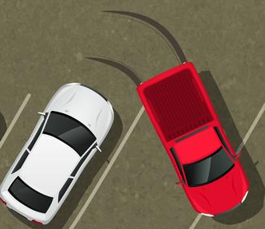
World and Machine Phenomena
Phenomena | Shared | Who controls
An authority notifies other authorities that he is going to check the violation | YES | World
Phenomena | Shared | Who controls
User inserts picture, type and description of the violation | YES | World
SafeStreets application detects date, time, position from device | NO | Machine
Phenomena | Shared | Who controls
User sends the violation report | YES | World
SafeStreets calculates the statistics | NO | Machine
Phenomena | Shared | Who controls
SafeStreets asks to the user to insert again some wrong data | YES | Machine
User inserts the license plate manually | YES | World
Phenomena | Shared | Who controls
Safestreets notifies authorities near violation which has occurred | YES | Machine
An authority goes in the place of the violation | NO | World
Phenomena | Shared | Who controls
User launches the application and logs in with his own credentials | YES | World
SafeStreets software is loaded checking the role of the user | NO | Machine
Phenomena | Shared | Who controls
User sees a traffic violation | NO | World
User wants to notify authorities | NO | World
SEES
CHECKS
LOGS IN
Authority
EndUser
INSERTS DATA
SENDS
NOTIFIES
WARNS
SafeStreets

Slide 12
World and Machine Phenomena
Phenomena | Shared | Who controls
SafeStreets receives data about accidents from municipality | YES | World
SafeStreets identifies unsafe areas | NO | Machine
SafeStreets suggests interventions | YES | Machine
SENDS ACCIDENTS
SUGGESTS
Municipality
SafeStreets

Slide 13
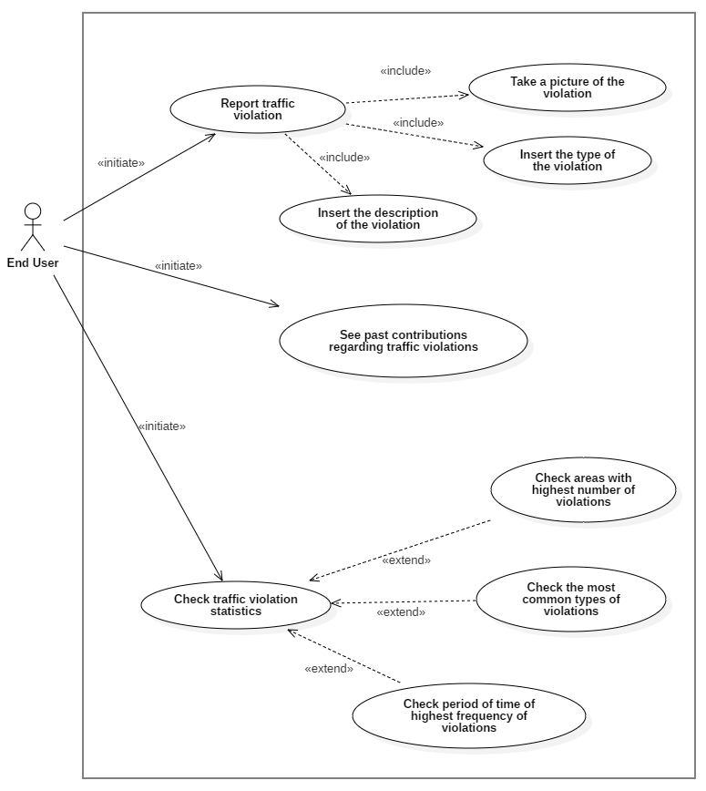
Use cases - EndUser

Slide 14
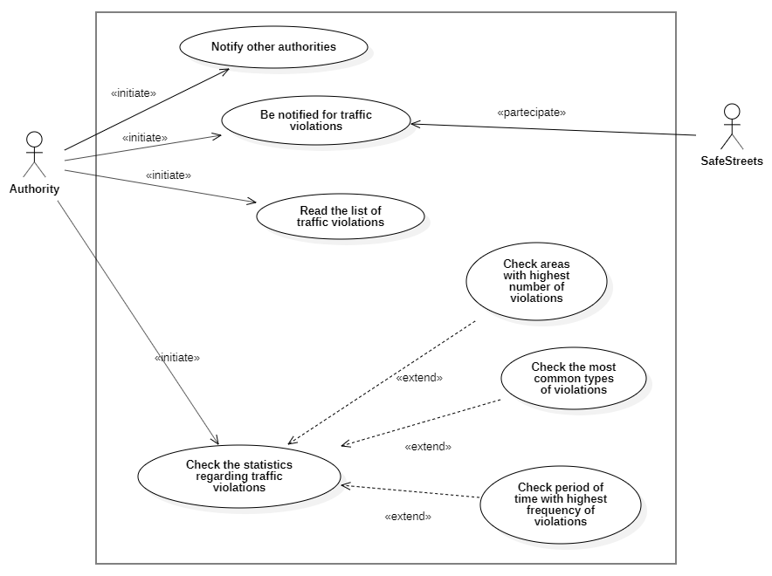
Use cases - Authority

Slide 15
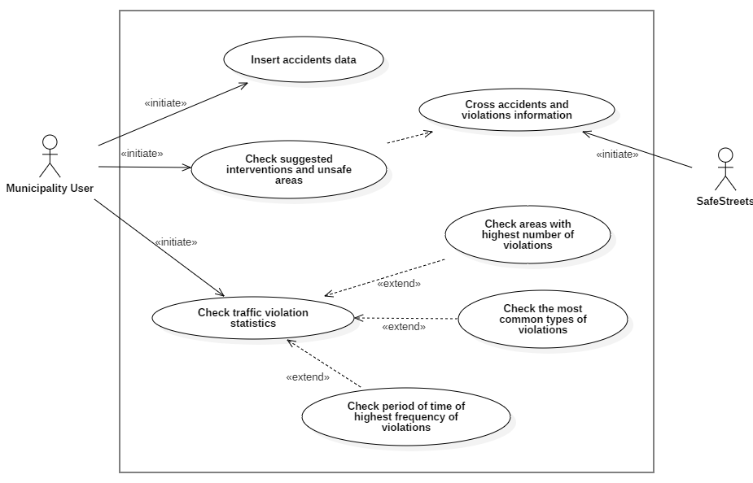
Use cases - Municipality

Slide 16
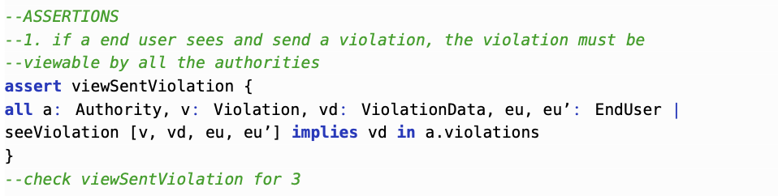
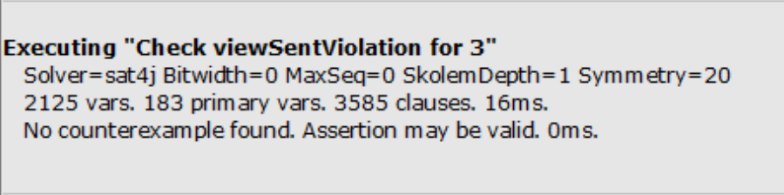
Alloy model – Assertion 1

Slide 17
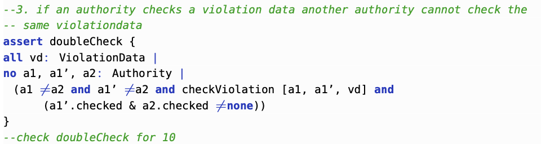
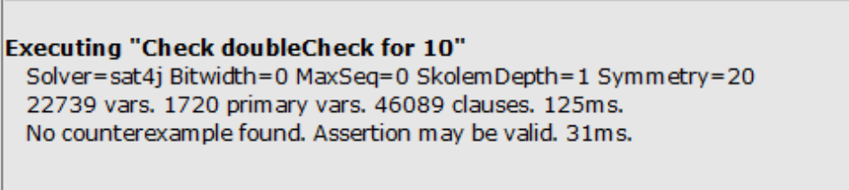
Alloy model – Assertion 3

Slide 18
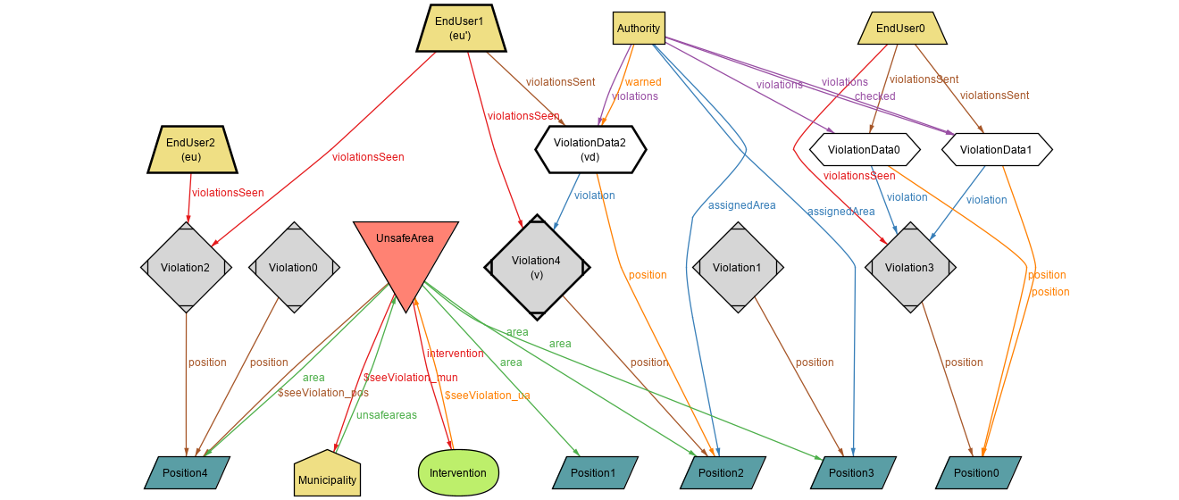
Alloy model – Predicate 1

Slide 19
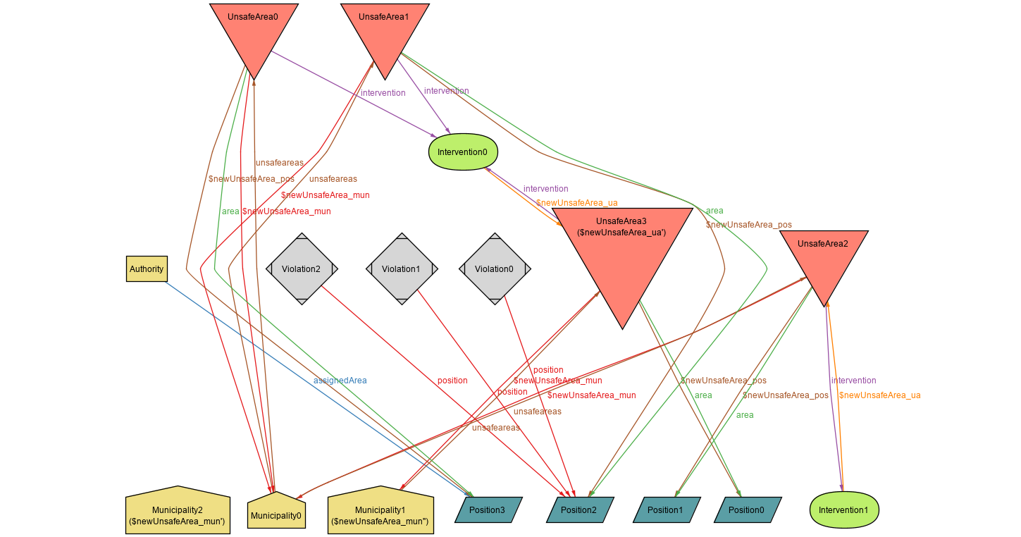
Alloy model – Predicate 4

Slide 20
Firma convenzione Politecnico di Milano e Veneranda Fabbrica del Duomo di Milano
Design Document
Aula Magna – Rettorato
Mercoledì 27 maggio 2015

Slide 21
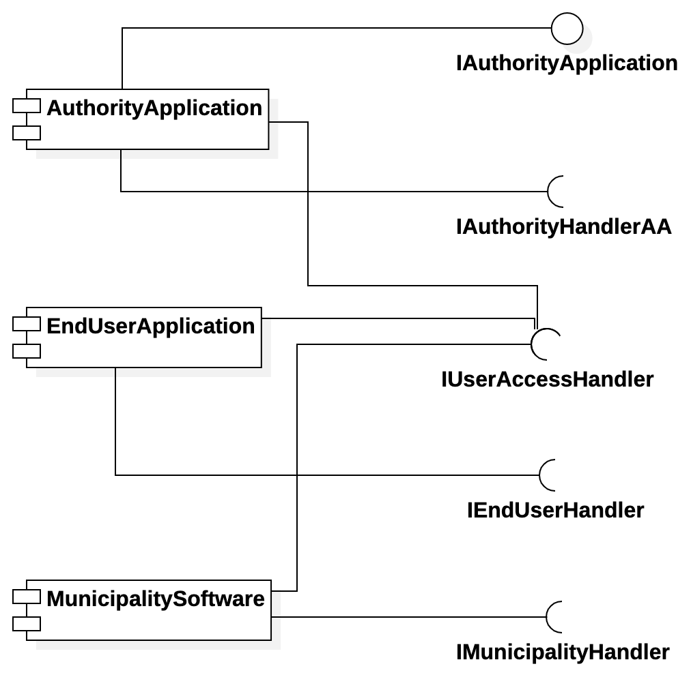
Components of the System – Client

Slide 22
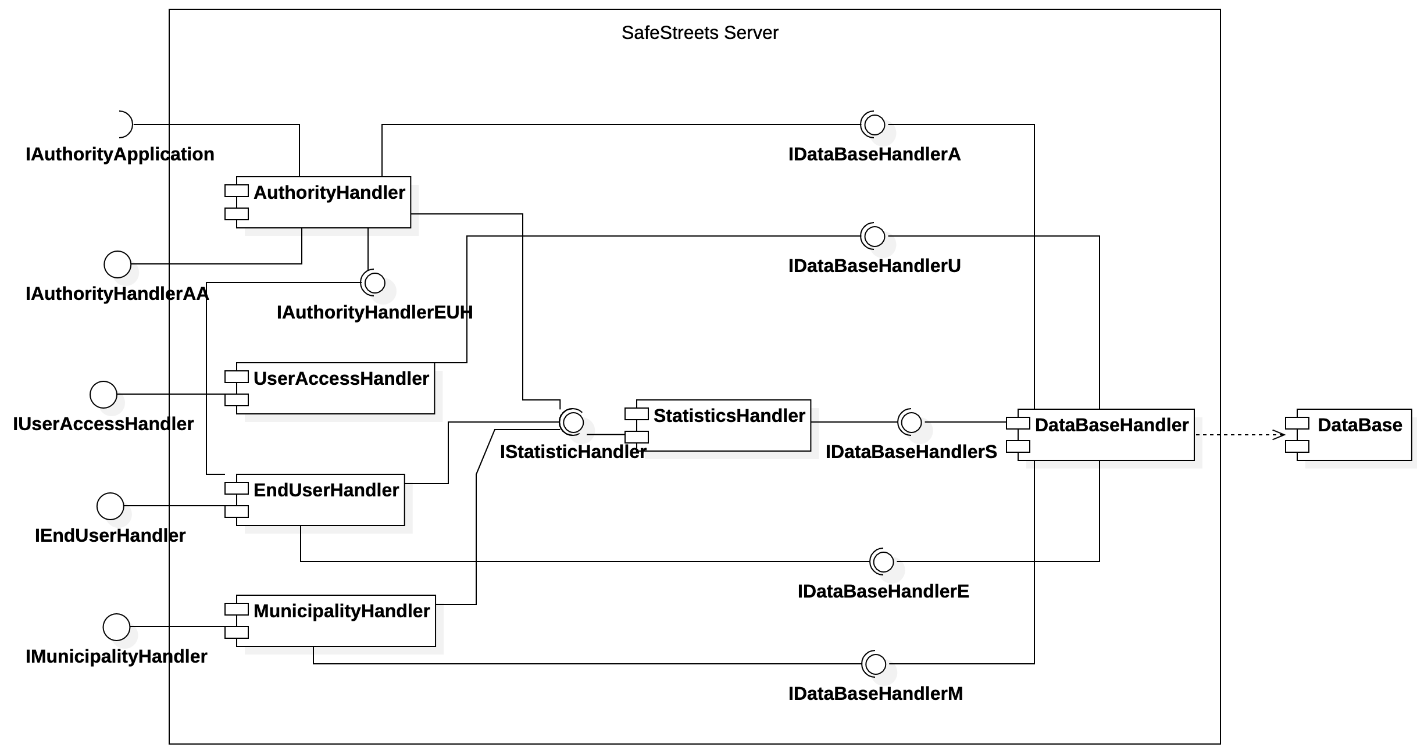
Components of the System - Server

Slide 23
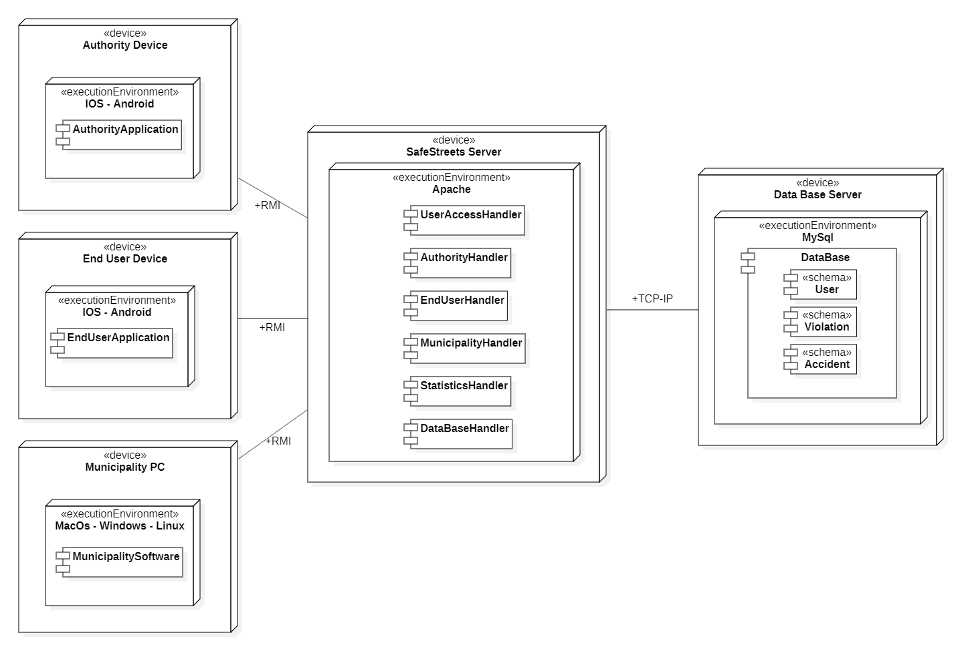
Selected architectural styles and patterns

Slide 24
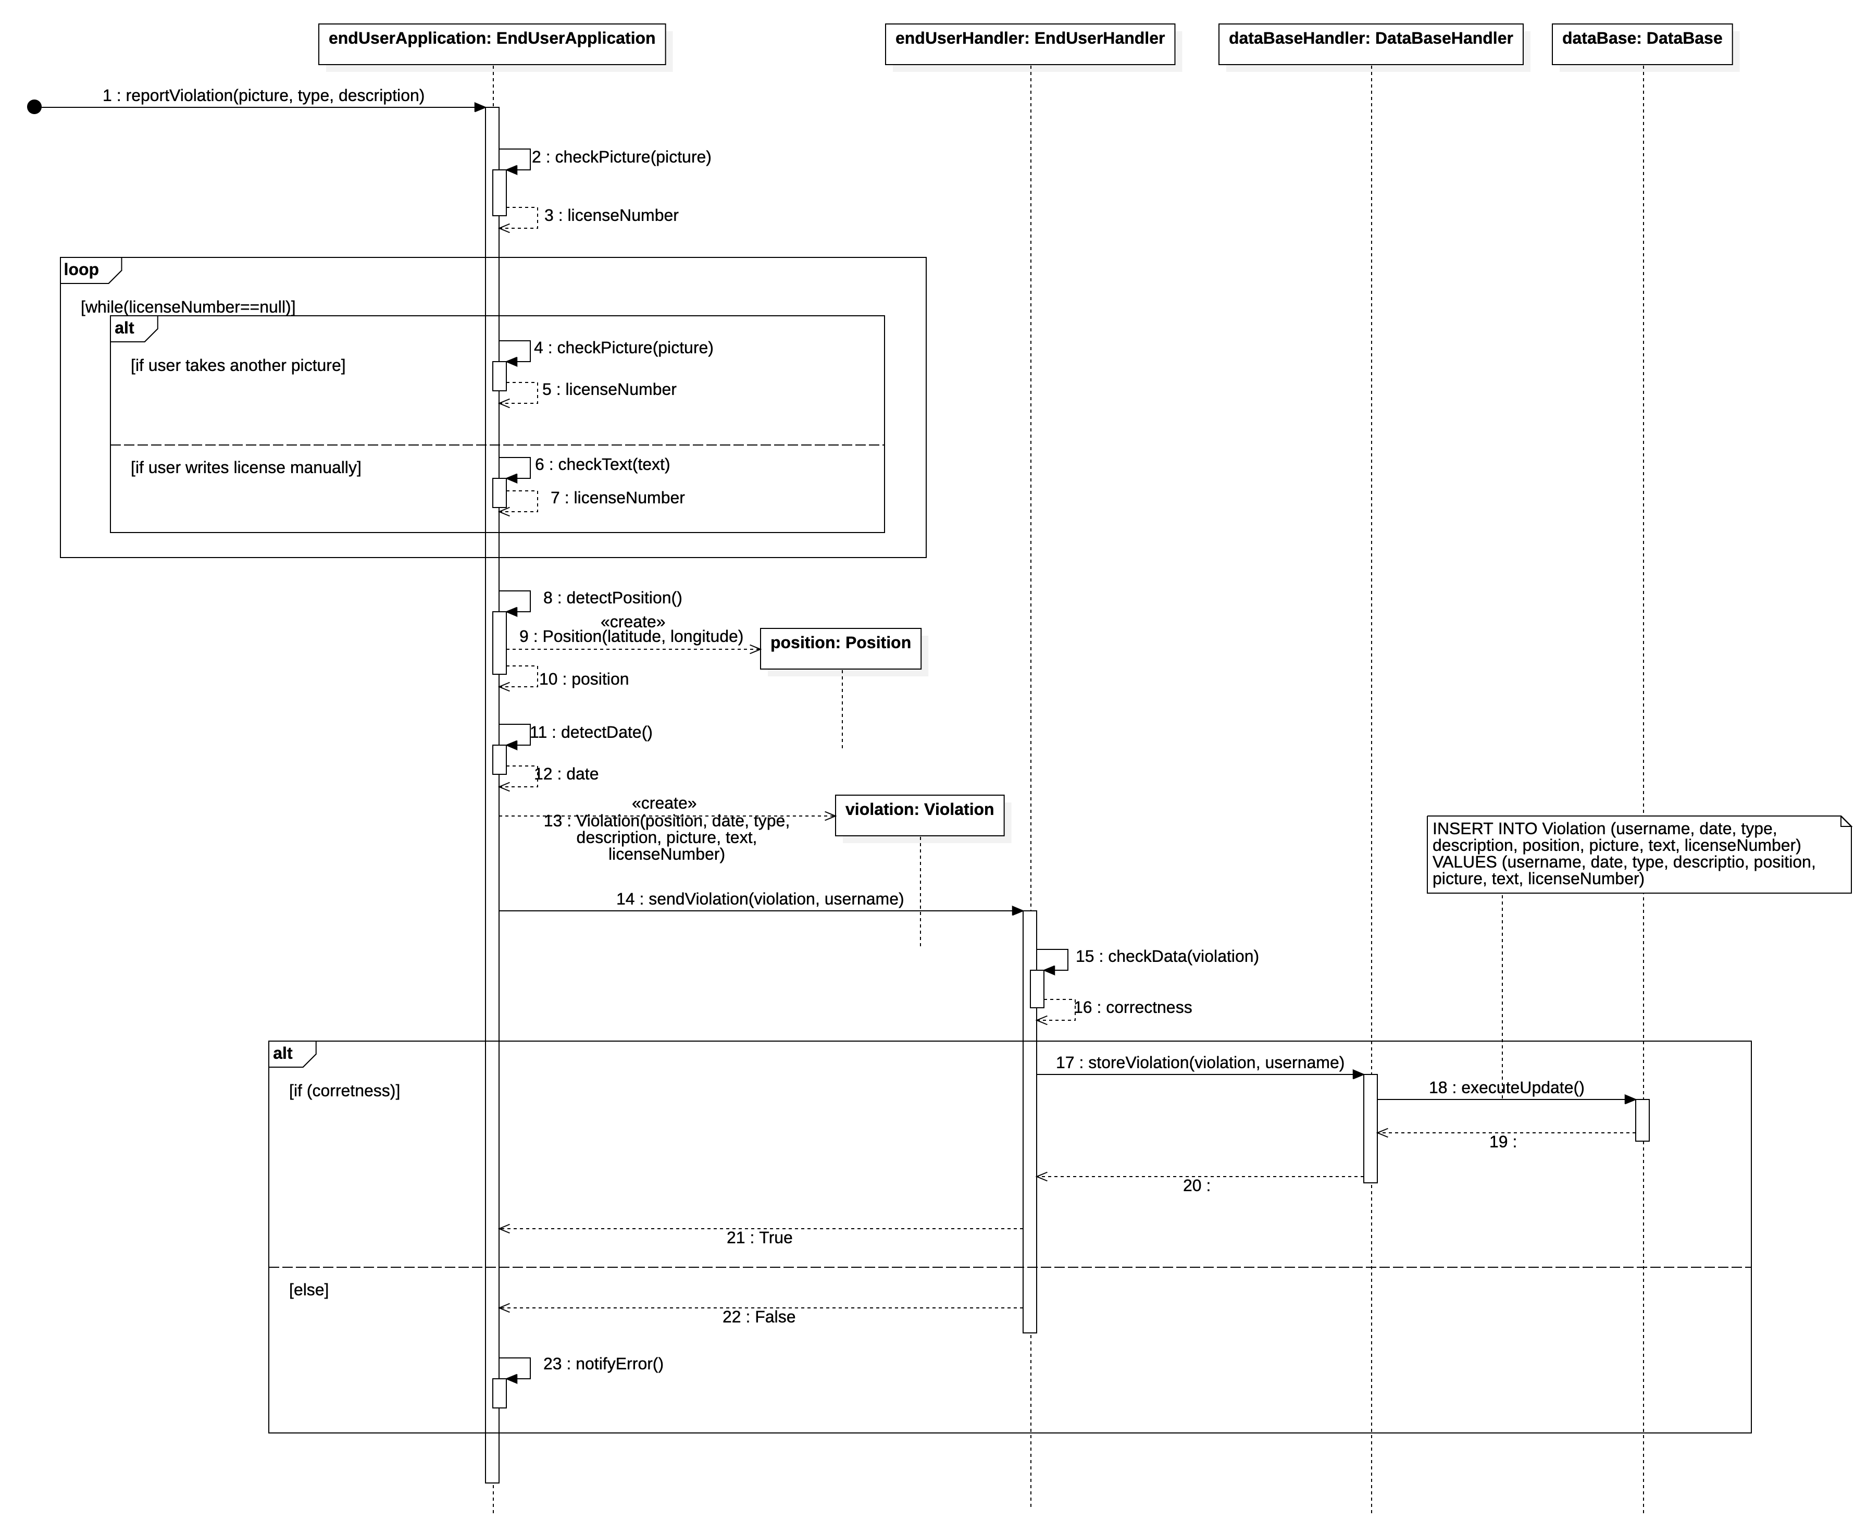
An end user create a new traffic violation

Slide 25
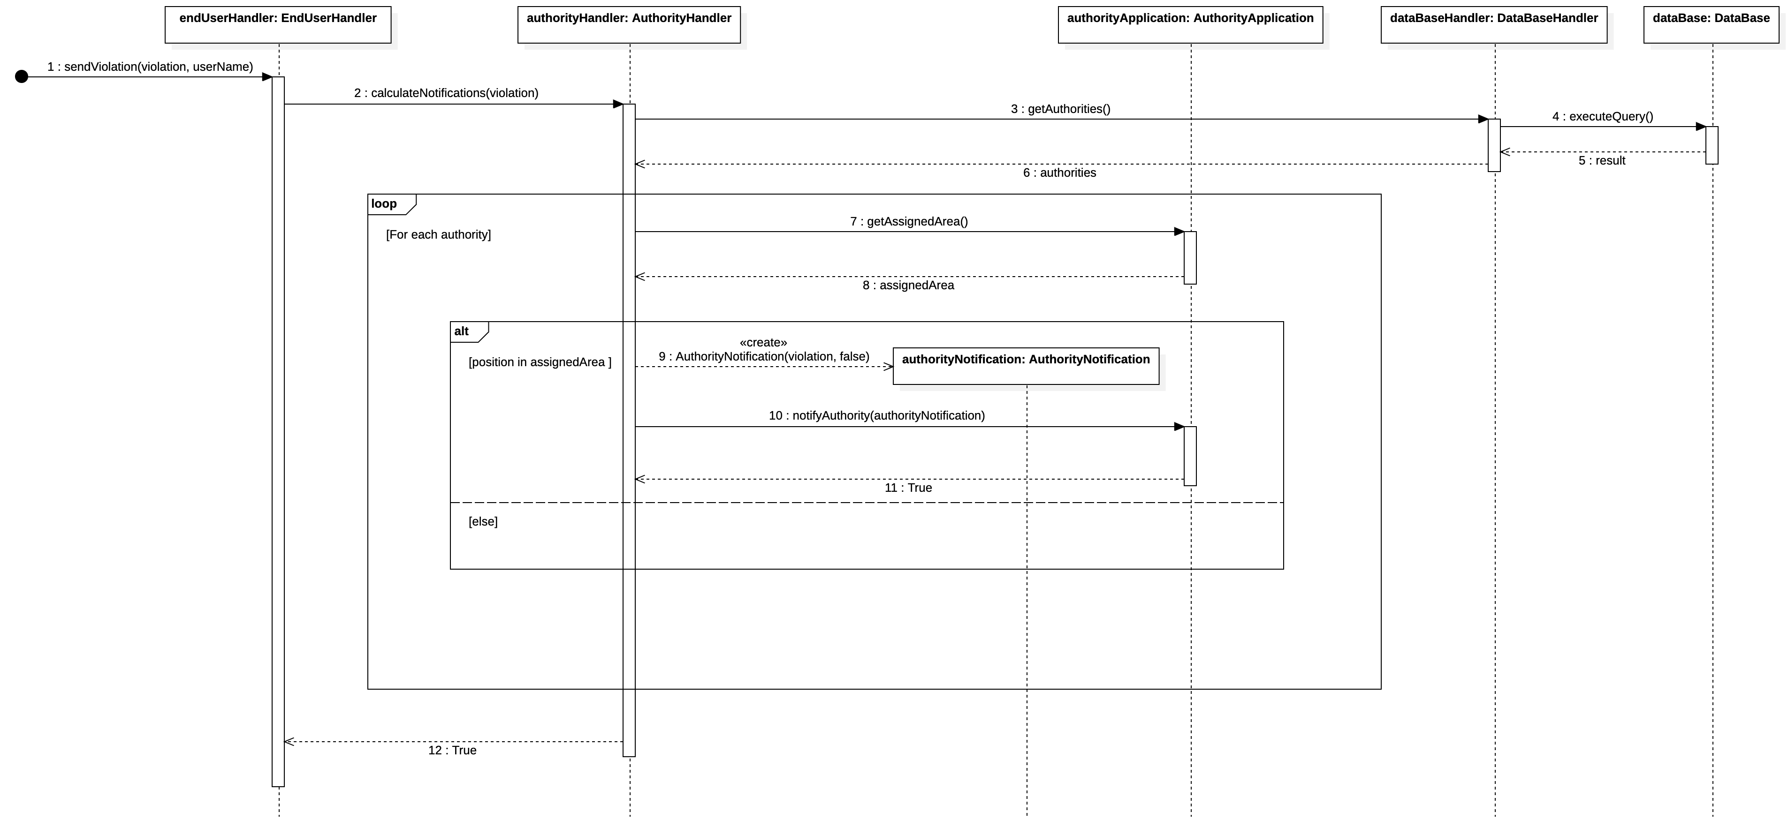
An authority user is notified for a violation

Slide 26
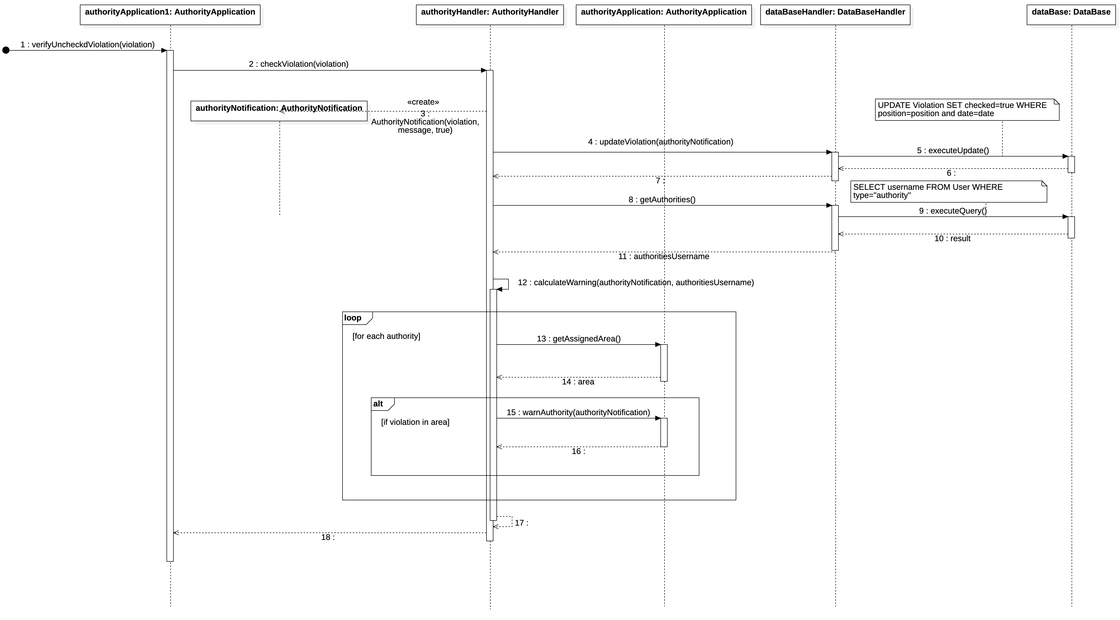
An authority user notifies other authorities

Slide 27
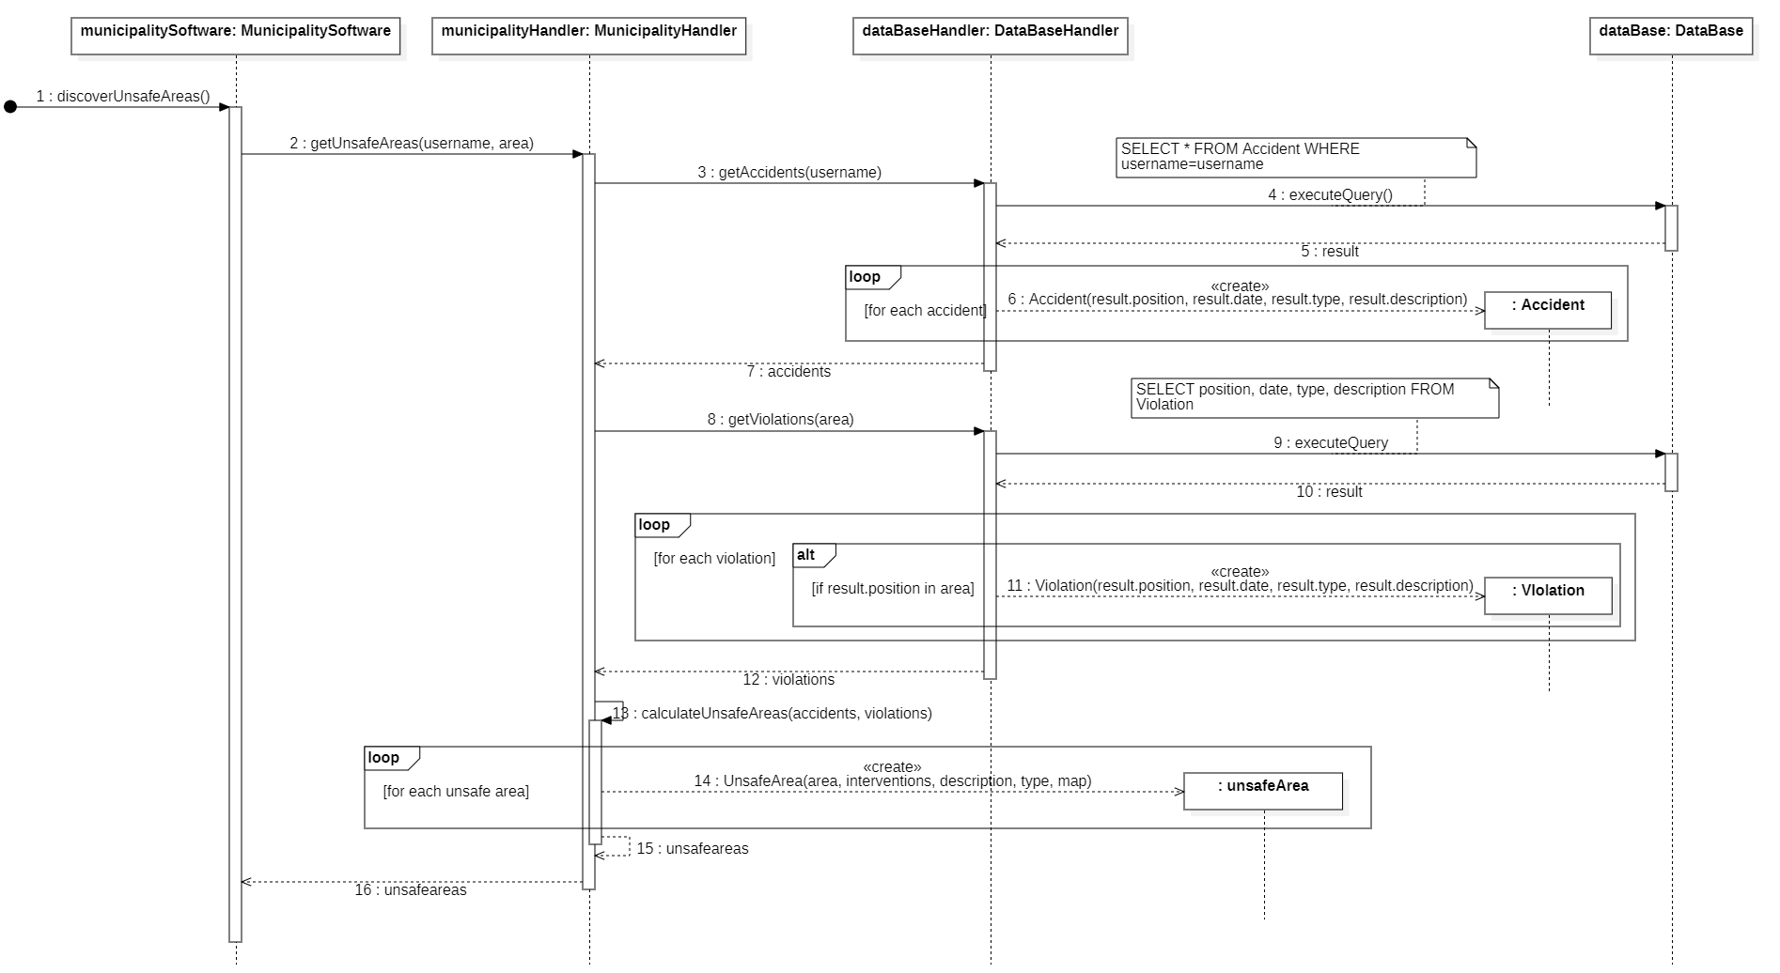
A Municipality user requests the unsafe areas and interventions

Slide 28
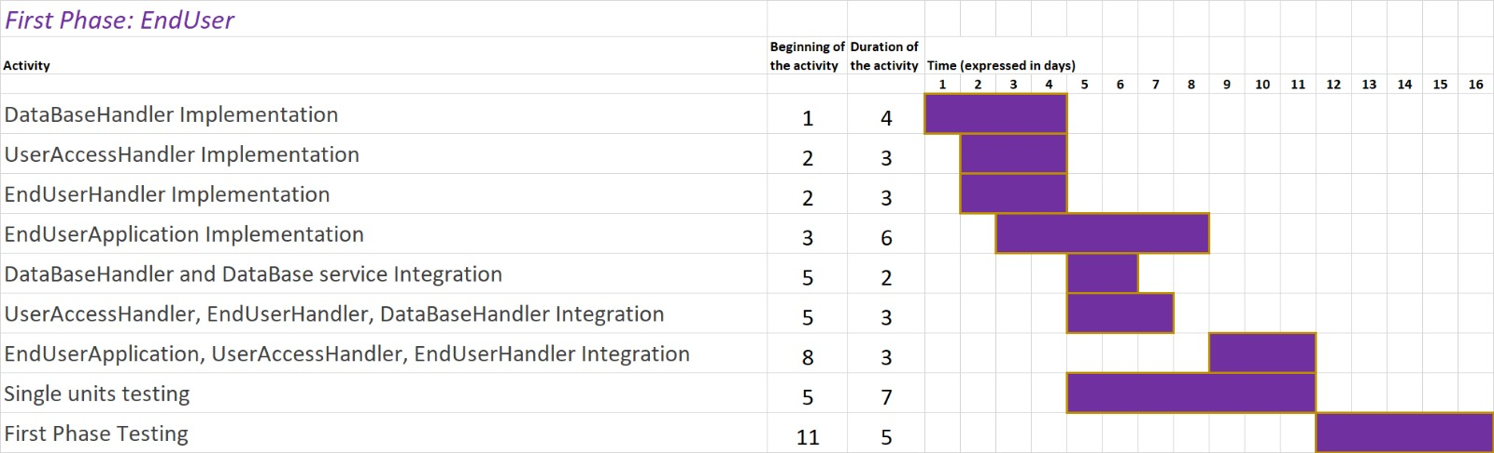
Gantt – First phase

Slide 29
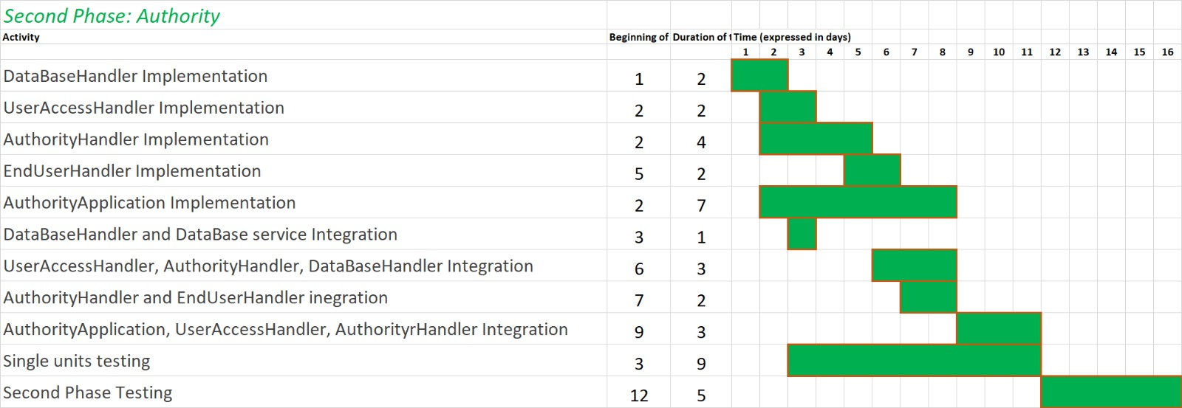
Gantt - Second phase

Slide 30
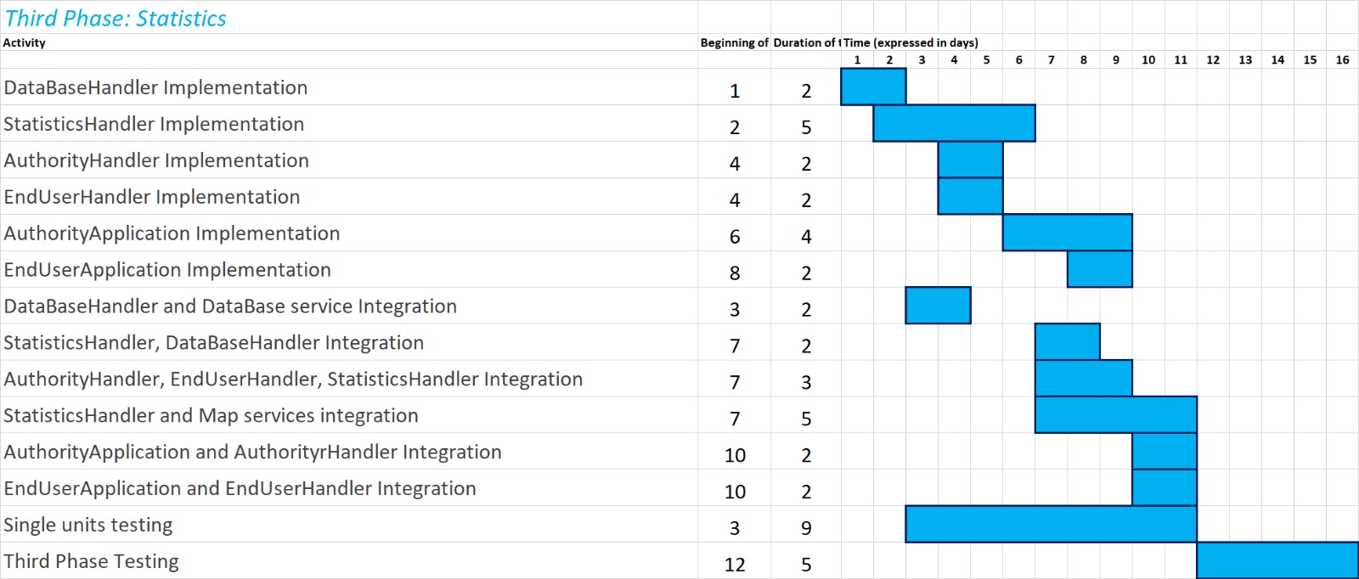
Gantt – Third phase

Slide 31
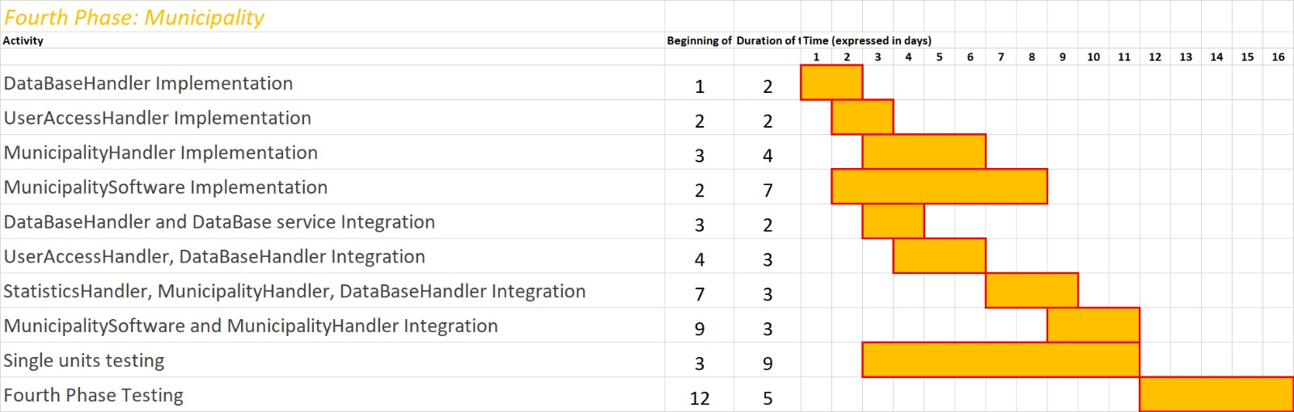
Gantt – Fourth phase

